Slide 1
Automatic Target Scoring
Application to do Image analysis and do scoring from a shot
ISSF paper target.
-- Ninad P. Chaudhari

Slide 2
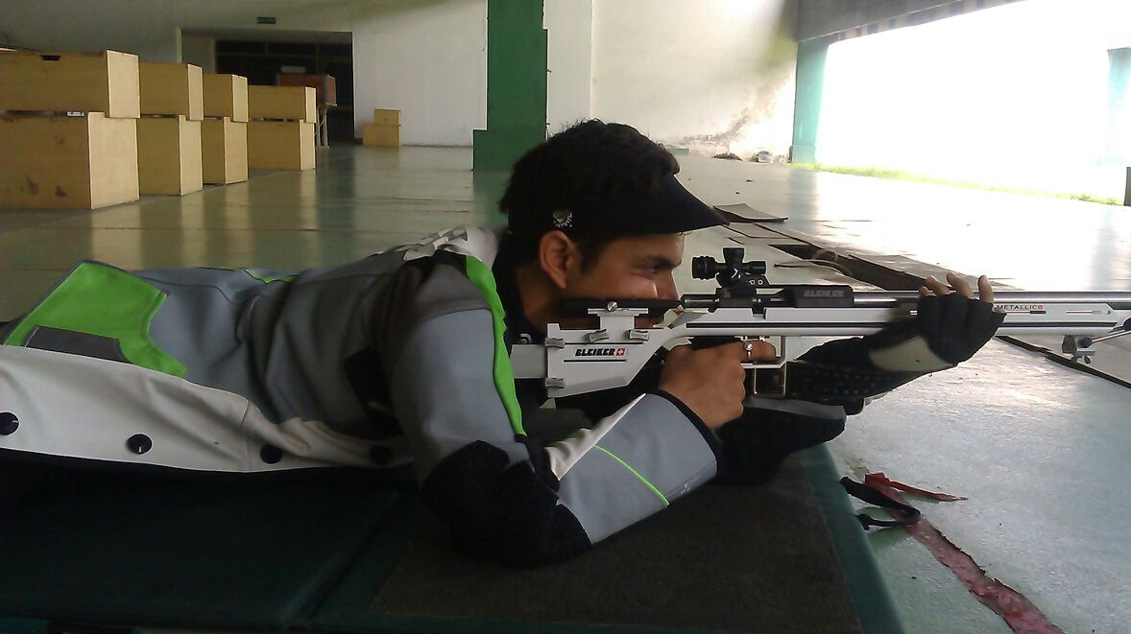
Motivation
Shooting – popular sport.
15 Events in Summer Olympics.
One shot per target, and 100s of targets.
International competition -> Electronic Scoring systems.
Small ranges rely on manual scoring
Notes:
Shooting is one of the popular sports played world-wide.
Total of 15 events are hosted in Shooting sport at the Summer Olympics.
Shooters shoot one shot per target and scoring is done as per international standards.
In International events there are electronic target systems which rely on grids of lasers or ultrasonic sound waves to get the position of shot on the target.
At local shooting ranges, however shooting is done on paper targets and scoring is done manually.

Slide 3
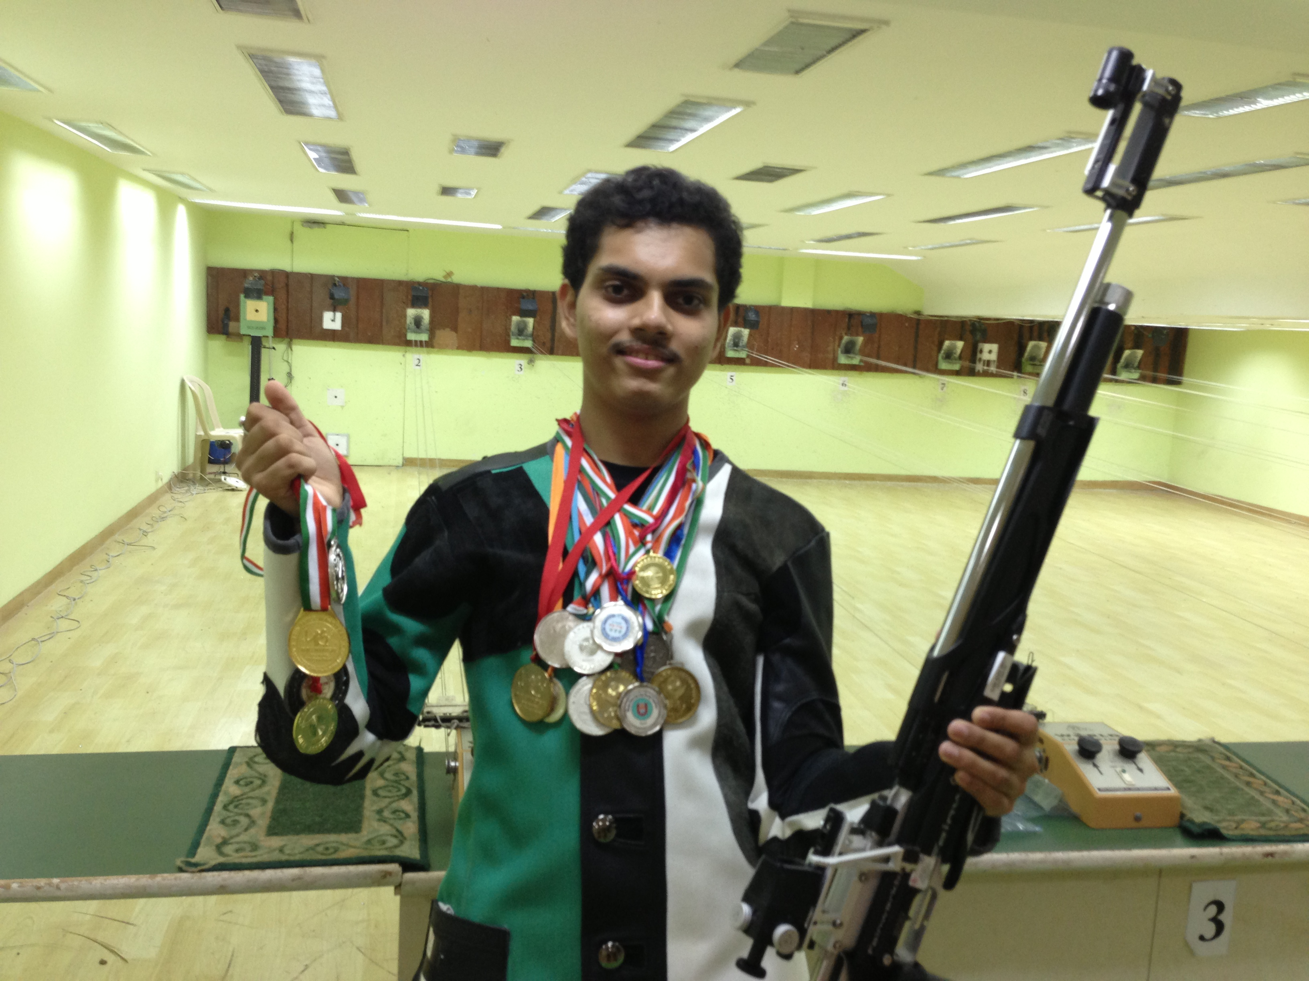
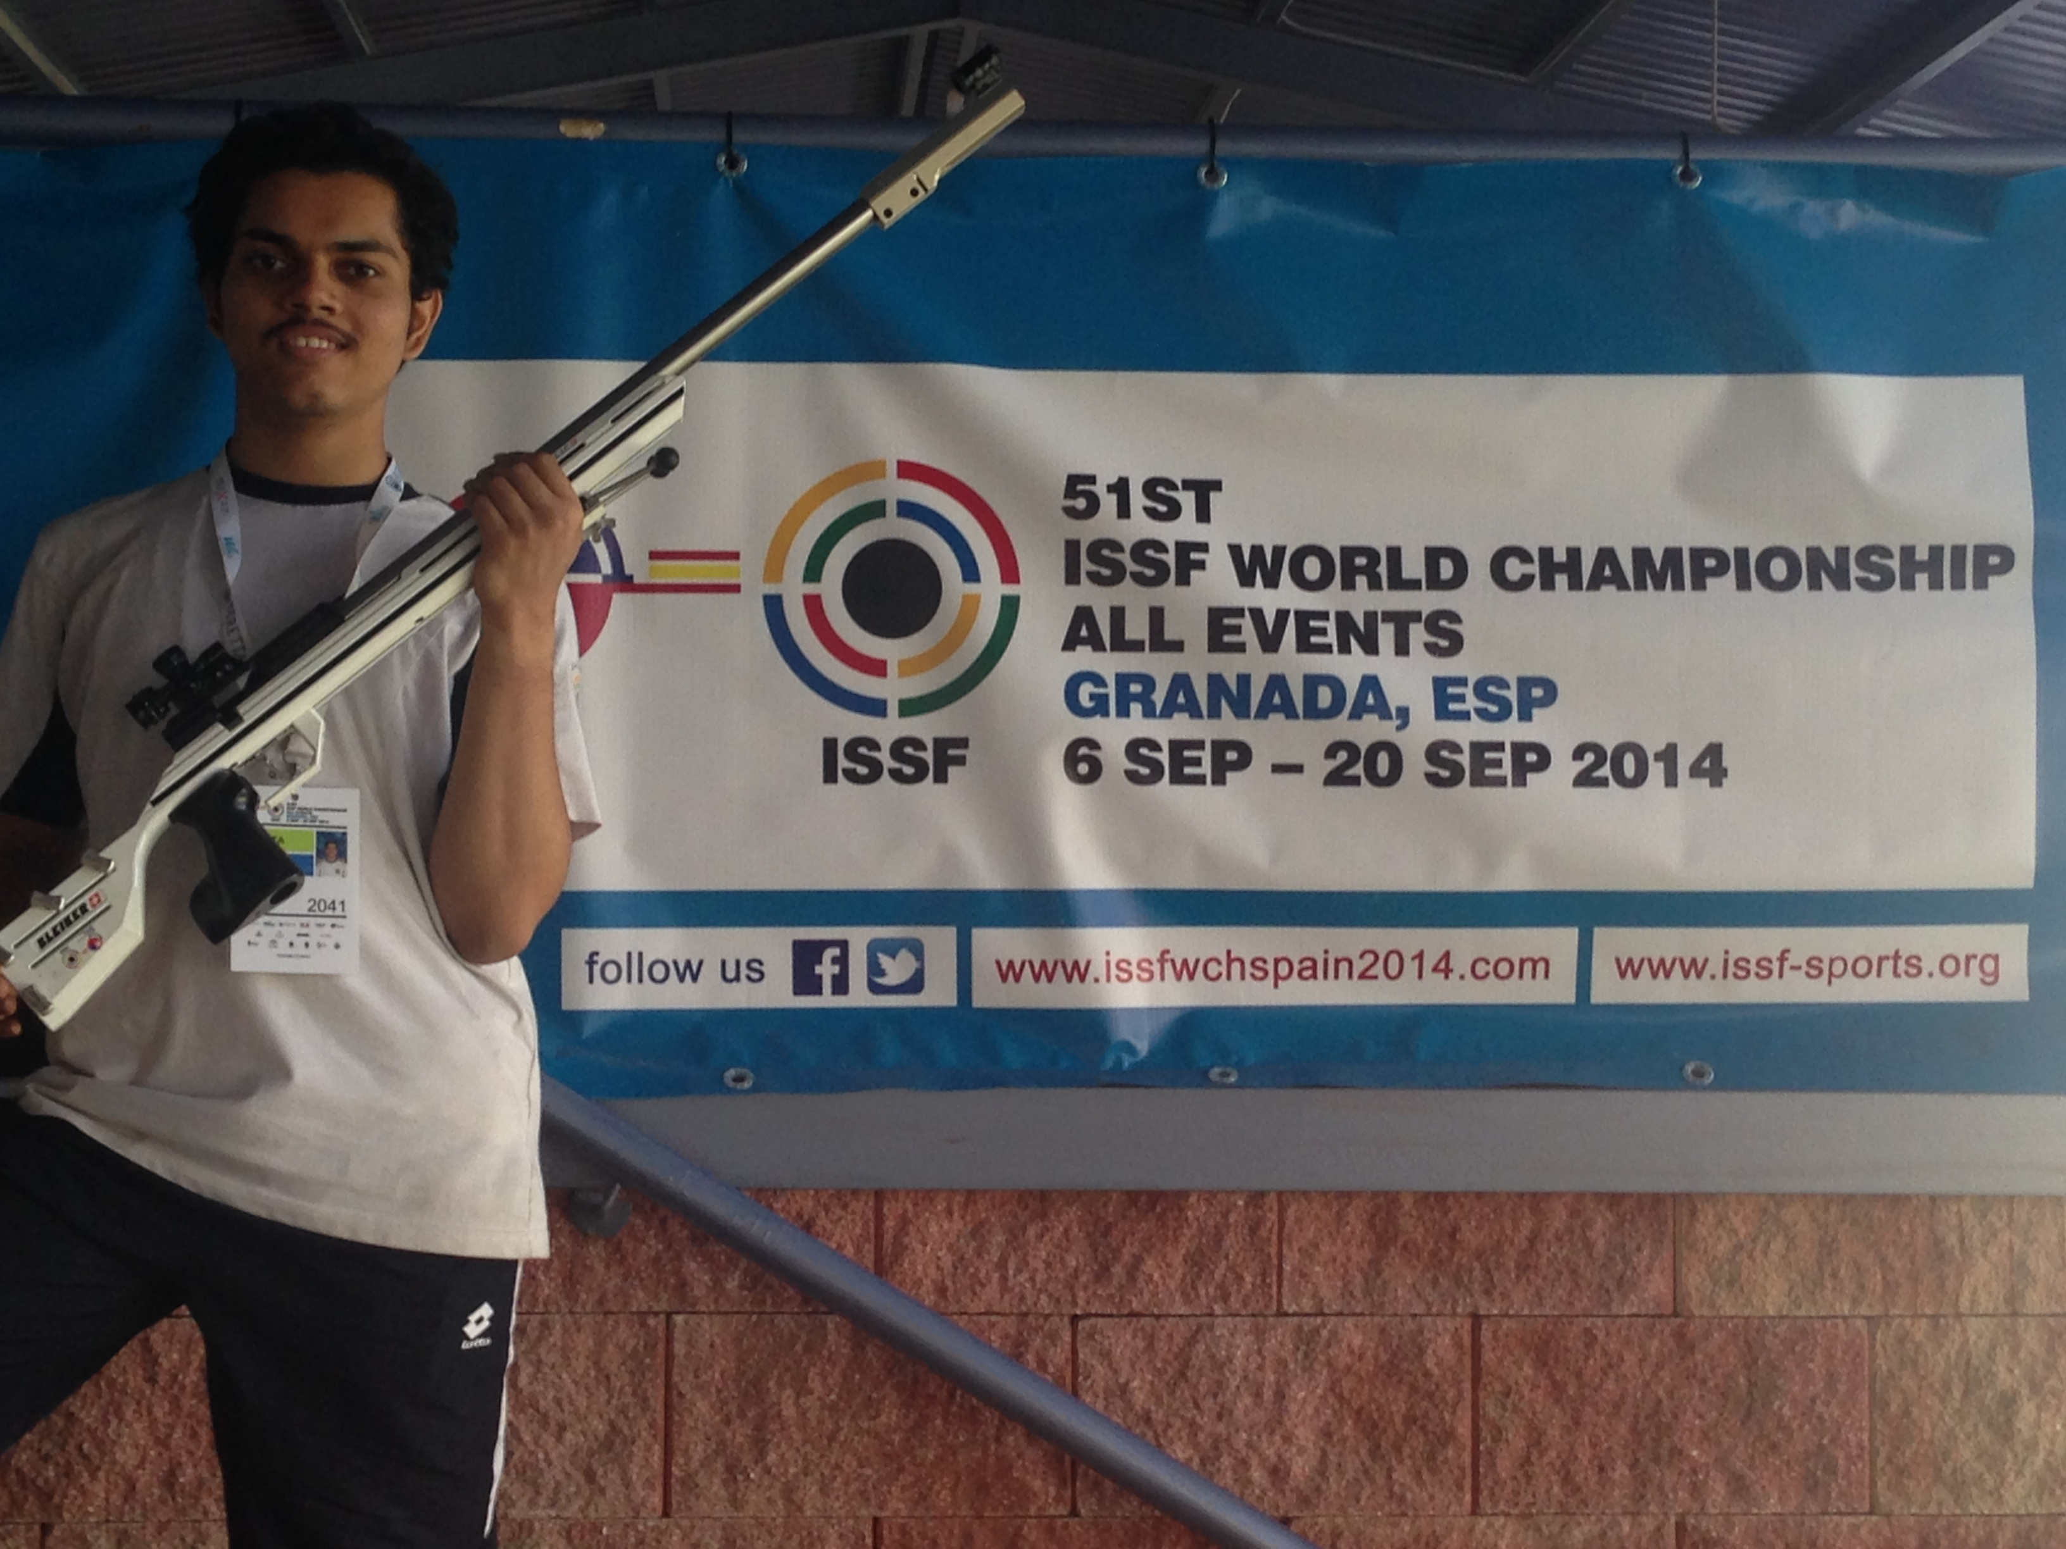
Background
Professional Athlete, part of Indian National Shooting Team.
International, multiple national medalist and 3 New National Records.
Life Member of National Rifle Association of India.

Slide 4
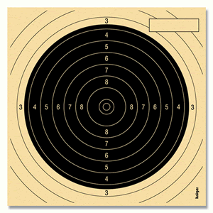
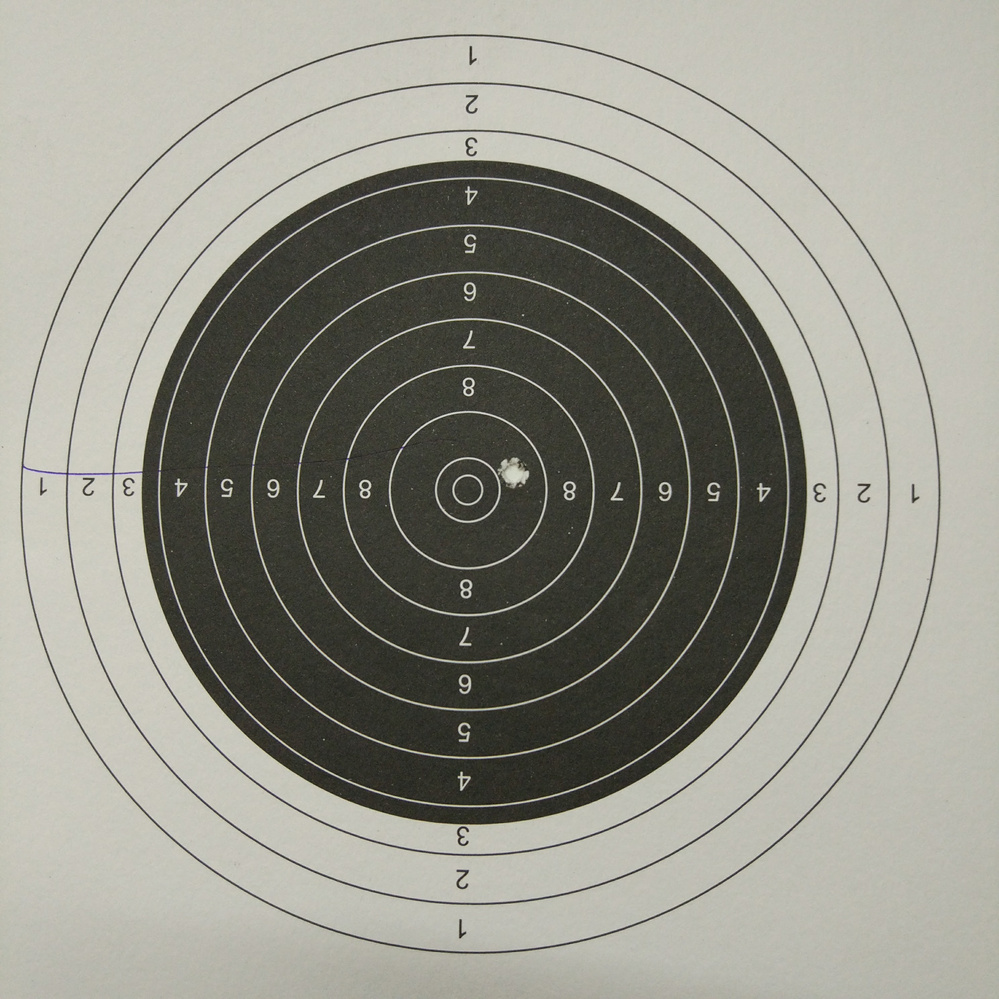
Sample Target { 50M Rifle}
Total Ø = 154.4 mm.
4 ring Ø = 106.4 mm.
9 ring Ø = 26.4 mm.
10 ring Ø = 10.4 mm

Slide 5
What I want to Achieve
Identify the target type.
Android app to automate the scoring.
Continuous scoring using video.
Should solve transformations problem.
Come close to International Accuracy standards.

Slide 6
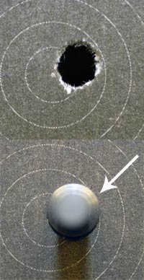
Challenges
BIGGEST : Accuracy and Precision to match the standardized methods.
Is that a 9 or a 10 =>
Image from : http://www.odcmp.org/0108/default.asp?page=SCORINGGAUGES
Notes:
Accuracy refers to the closeness of a measured value to a standard or known value. For example, if in lab you obtain a weight measurement of 3.2 kg for a given substance, but the actual or known weight is 10 kg, then your measurement is not accurate. In this case, your measurement is not close to the known value.
Precision refers to the closeness of two or more measurements to each other. Using the example above, if you weigh a given substance five times, and get 3.2 kg each time, then your measurement is very precise. Precision is independent of accuracy. You can be very precise but inaccurate, as described above. You can also be accurate but imprecise.

Slide 7
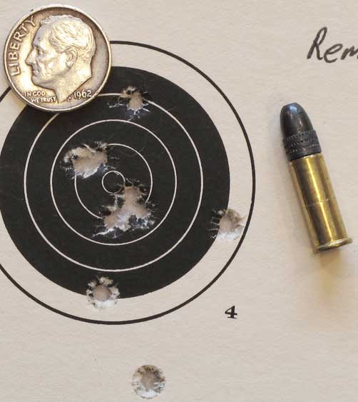
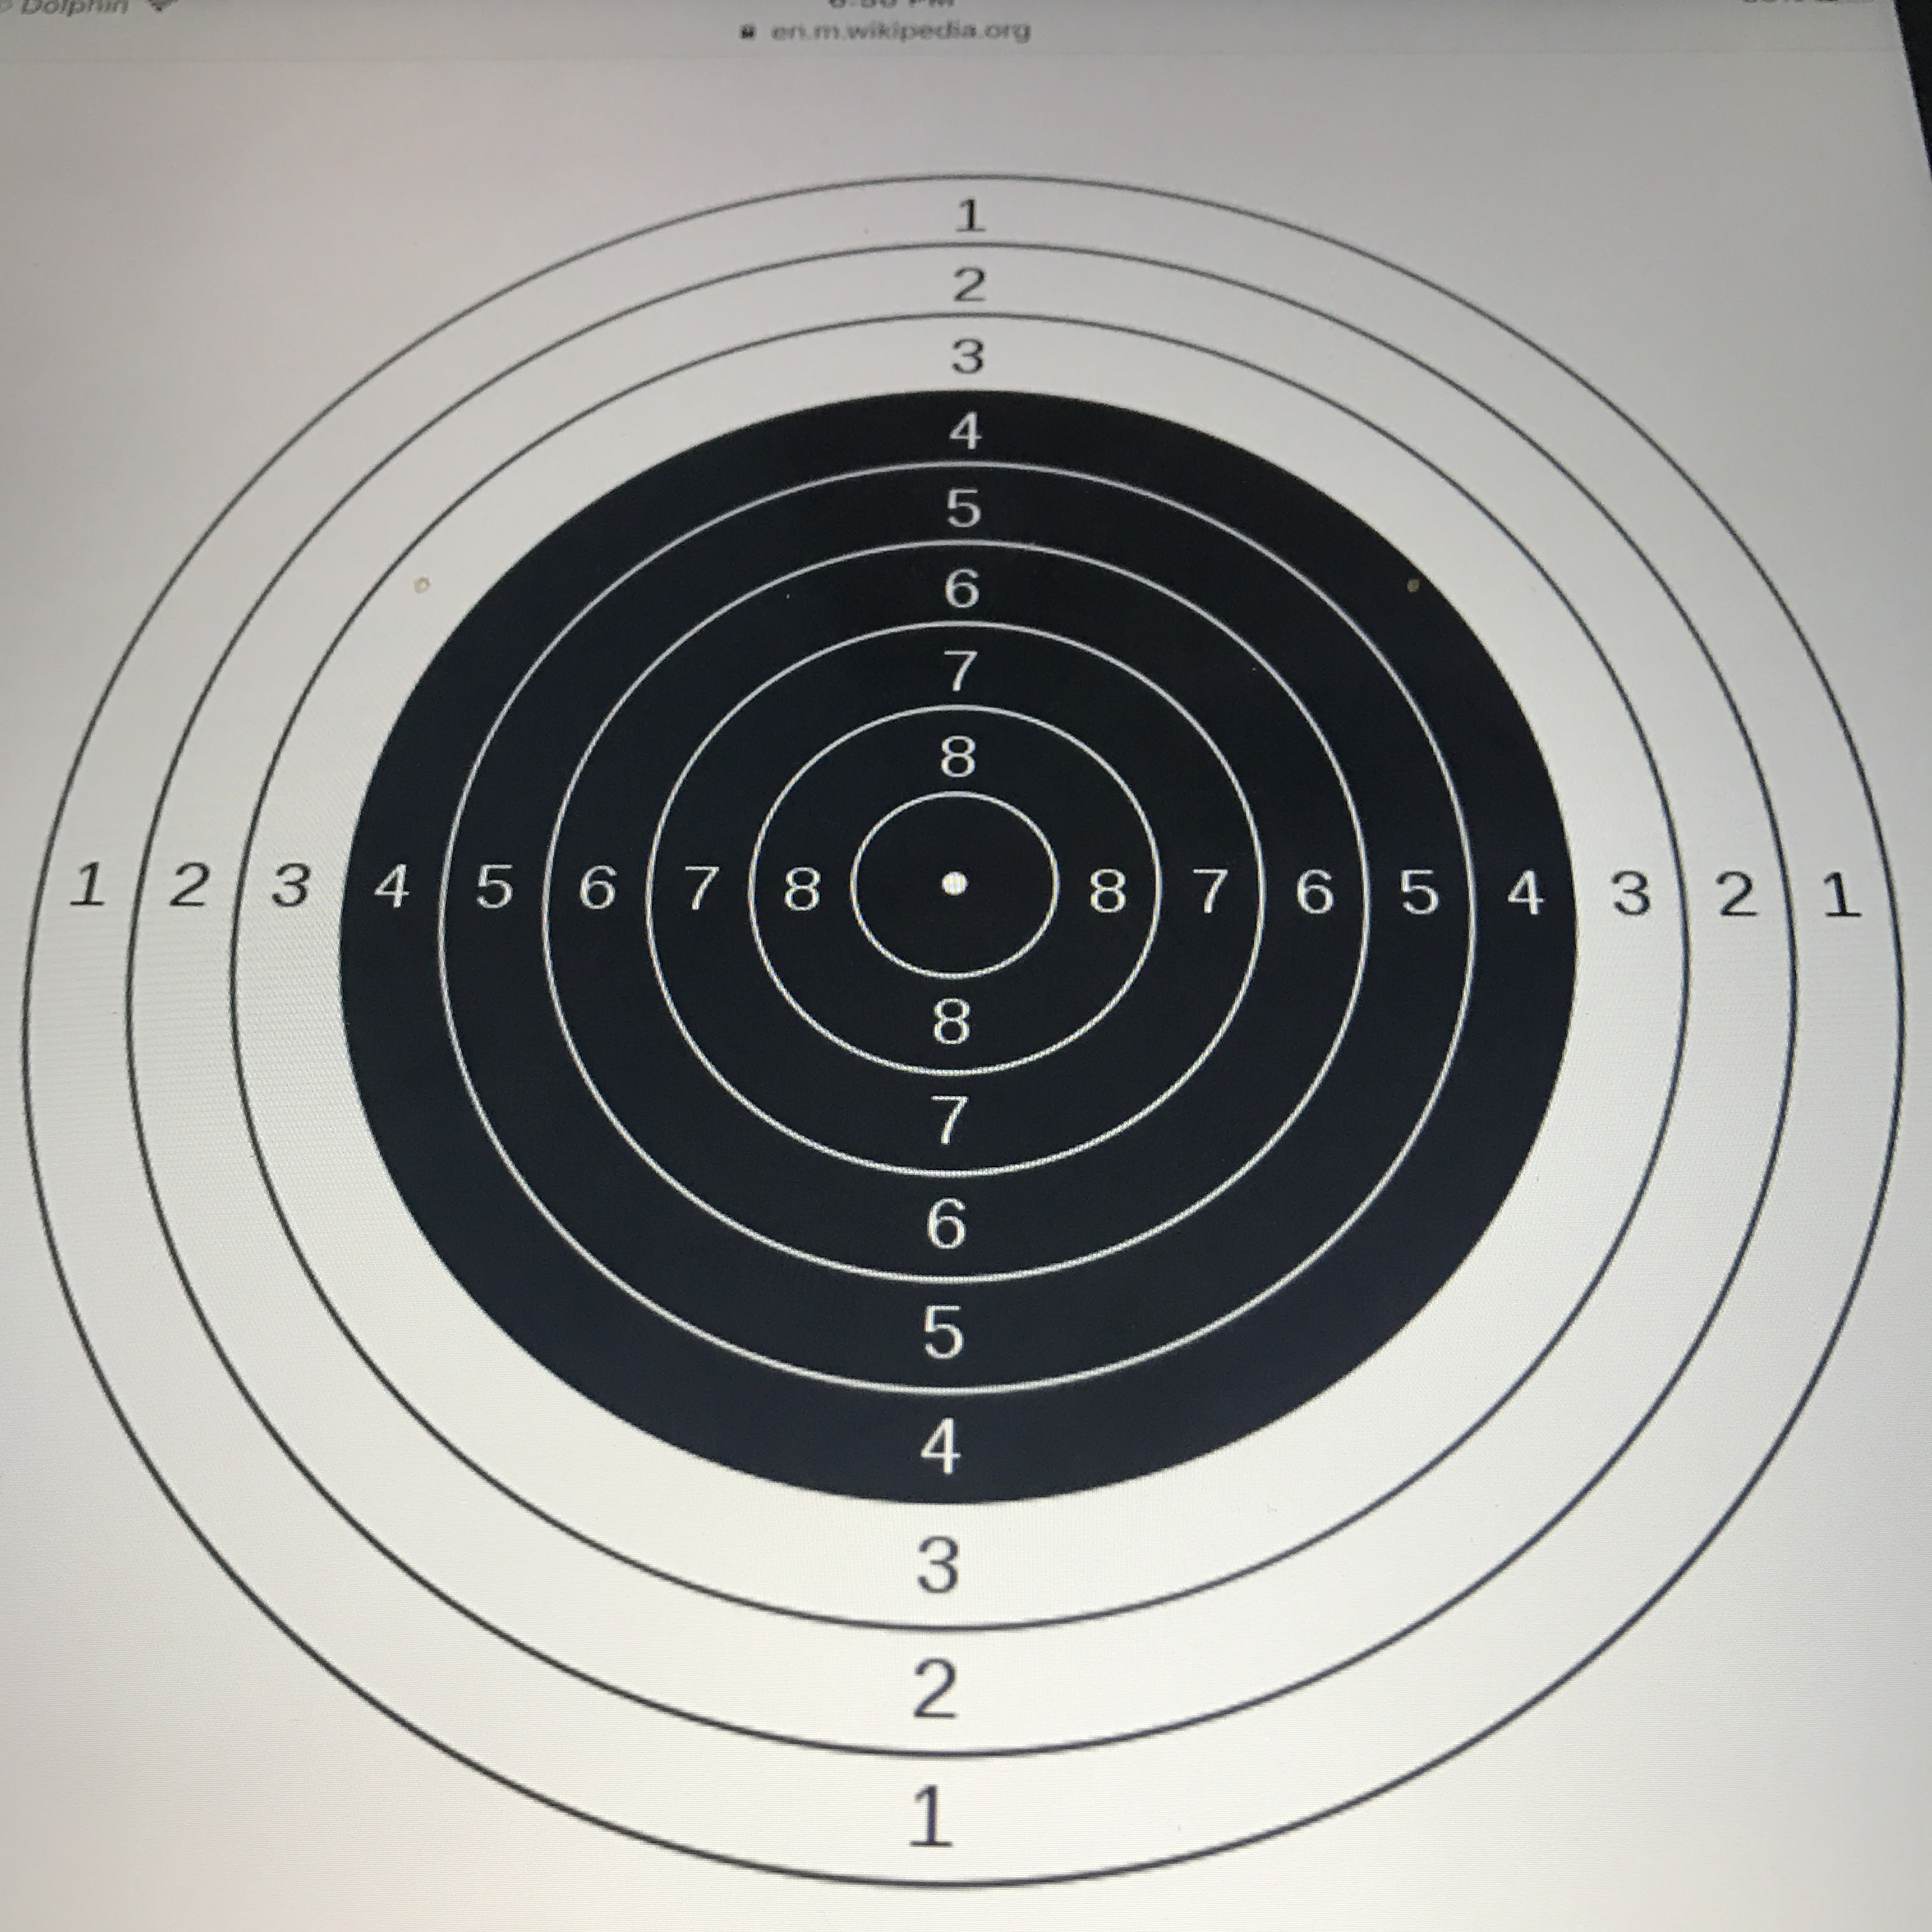
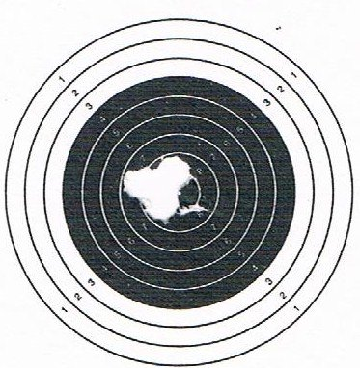
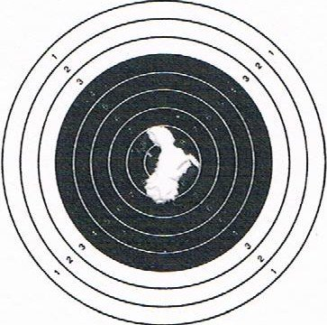
Challenges Continued
Imperfect shot hole.
Paper cut due to shot.
Shots on black part is still okay,
Check shots on white background.

Slide 8
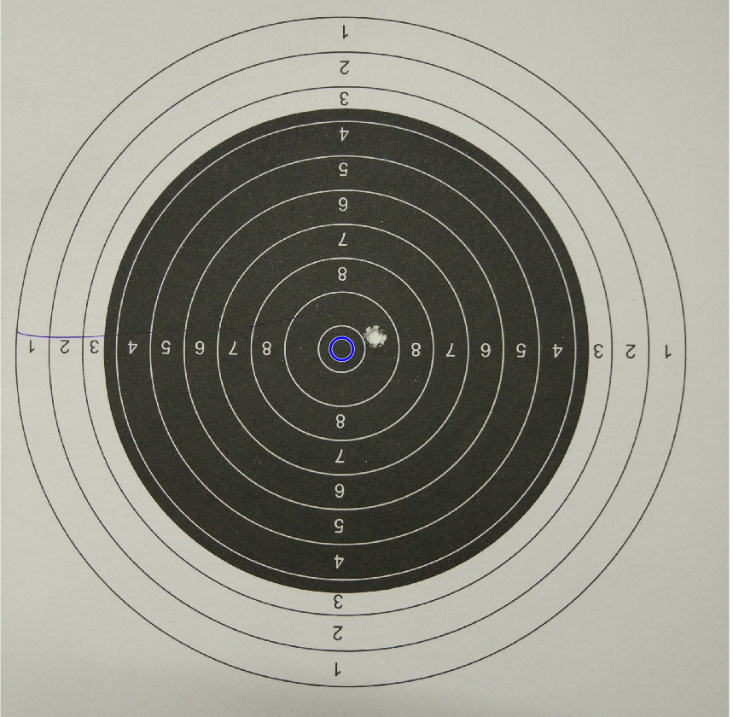
Challenges Continued
Computation on a mobile device.
Lighting differences.
Scaling Challenges.
Zero shot.
Hough circle – Matlab took 15 sec on i7 machine!

Slide 9
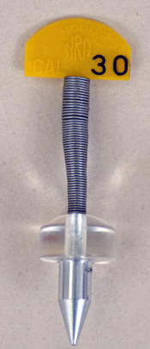
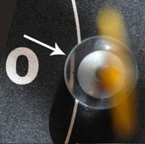
Gauges
Gauges are used to accurately measure the score of each shot.
Images from : http://www.odcmp.org/0108/default.asp?page=SCORINGGAUGES
Notes:
Accuracy refers to the closeness of a measured value to a standard or known value. For example, if in lab you obtain a weight measurement of 3.2 kg for a given substance, but the actual or known weight is 10 kg, then your measurement is not accurate. In this case, your measurement is not close to the known value.
Precision refers to the closeness of two or more measurements to each other. Using the example above, if you weigh a given substance five times, and get 3.2 kg each time, then your measurement is very precise. Precision is independent of accuracy. You can be very precise but inaccurate, as described above. You can also be accurate but imprecise.

Slide 10
Approach to solve the problem.
Hough transform for circles.
SIFT Features – Target detect!
Pattern (blob) Matching.
Ratio of diameters of shot and black part to solve scaling issues.
Research how to use the same on Android – Java implementations of OpenCV , Android NDK-Native Development Kit and C++ wrappers.
Lower FPS and lower video capture size.

Slide 11
Criteria for success (For 50M target)
100% Goal : Develop an android app that Is capable of live detection of scores.
75% Goal : Develop android app that can least do score detection in an image.
50% Goal: Develop program to give score in Matlab.
125% Goal : Achieve High precision as required by the international standards.

Slide 12
Proposed timeline
October:
Research on precision and target analysis.
Research on ways to have CV in mobile devices.
November:
Develop techniques for shot detection on ideal images.
Develop techniques for shot plot on ideal images.
Improve the algorithm to work with non-ideal conditions.
December:
Port the same to android.

Slide 13
Thank You

